Slide 1
The NSF/BSF Program:
Tips for Writing a Successful Proposal
Keith R. Dienes
Program Director
MPS/ Physics Division
National Science Foundation
September 2019

Slide 2
A “successful proposal” is one that wins funding.
Israel has some of the best and most innovative scientists in the world.
…but all funding for Israeli scientists under the NSF/BSF program comes from BSF!
So why should an NSF Program Director come all the way to Israel to tell you how to win funding?
Well, Israel is a fascinating country and I am really happy to visit…

Slide 3
But most importantly…
For NSF/BSF proposals, it is NSF that handles every aspect of the scientific review…
The relevant NSF Program Director reads the proposal
The NSF Program Director (with assistance from support staff) determines whether it is compliant (meets the minimum regulations concerning format and content --- to be discussed)
The NSF Program Director selects appropriate reviewers (either ad-hoc reviewers or Panelists or both --- to be discussed)
The NSF Program Director evaluates the recommendations of the reviewers, and also assesses other programmatic concerns that go beyond the reviewers (to be discussed).
The NSF Program Director “makes the recommendation” (i.e., decides) whether to fund it or not, and at what level
… and the BSF has automatically committed to follow the lead of NSF!

Slide 4
So, when you are writing your NSF/BSF proposal, you are mostly writing to (and hoping to impress)…
External reviewers who are most likely to be based in the US and who are used to the NSF / American funding culture (which can be very different than the Israeli culture in many important ways)
Panelists who are most likely to be drawn from US institutions and who will carry certain expectations of their own into the Panel room
NSF Program Directors who have their own cultural expectations and programmatic constraints
In this talk, I will aim to focus on these aspects of the reviewing process, and provide tips for things that tend to work --- and things that don’t --- at each stage of NSF’s proposal evaluation process.

Slide 5
Step 1: Deciding whether to apply
Answering this question requires two separate evaluations:
Is the proposed research area appropriate for NSF?
Do you have a credible American research partner who will join you on this proposal?
    NB: In this talk, “American” means based in the US. Actual US citizenship or immigration status of the researcher is irrelevant to NSF.
To answer the first question, you need to understand the NSF context: what our mission is, what we fund, and how we are organized. This will tell not only if you should apply, but also where you should apply and what kind of proposal is most likely to resonate.

Slide 6
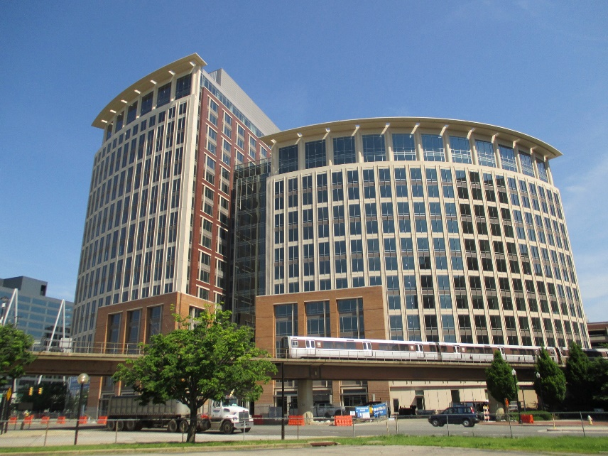
NSF: The U.S. National Science Foundation
“Where Discoveries Begin”
http://www.nsf.gov/
An independent agency of the US Federal government, established in 1950
Thousands of employees, hundreds of Program Directors in almost every branch of the sciences
NSF headquarters in Alexandria, Virginia (just outside Washington DC)
New!! (moved in August 2017)

Slide 7


NSF Mission and Goals
Mission: To promote the progress of science; to advance the national health, prosperity, and welfare; to secure the national defense…
Strategic Goals include:
  To transform the frontiers of science and engineering
  To stimulate innovation and address societal needs through research and education
Note!! Very important for NSF!

Slide 8
NSF is Unique Among US Federal Agencies
Mandate to fund both research and education
Focus on basic research in all areas of science & engineering
All areas of science, engineering, computer science, and social sciences are housed in one agency
Funding decisions are based on advisory peer review to Program Directors. Program Directors (many of whom are current and/or former university faculty) also have discretion to use their own scientific judgments and to set direction/balance portfolio.

Slide 10
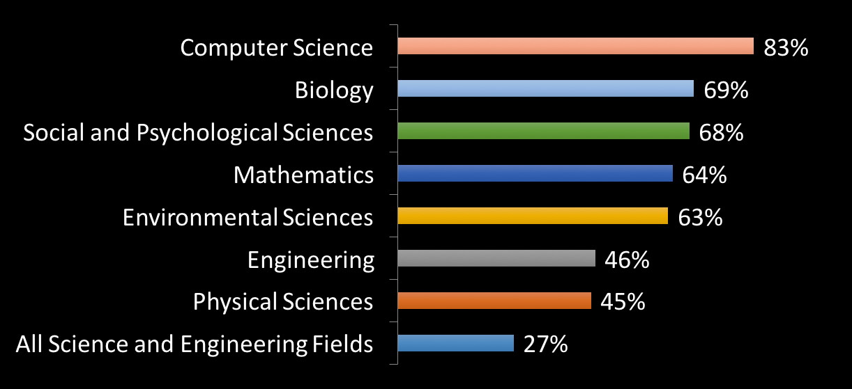
NSF Support of Academic Basic Research in Selected Fields
(as a percentage of total federal support in 2015)
fairly substantial!
Note: Biology includes Biological Science and Environmental Science. Biology and Psychological Sciences exclude National Institutes of Health funding from the total amount of federal support.
Source: NSF/National Center for Science and Engineering Statistics, Survey of Federal Funds for Research and Development

Slide 11

NSF Organization Chart
Budget numbers are FY2016 Actuals
NSF is organized in terms of Directorates:
Office of Diversity & Inclusion (ODI)
National Science Board
(NSB)
Director
Deputy Director
Office of the General Counsel (OGC)
$7,494 M
NSF total
Office of International Science & Engineering (OISE)
$49M
Office of the
Inspector General
(OIG)
NSB Office
Office of Integrative Activities (OIA)
($4.3M)
($14.8M)
Office of Legislative &
Public Affairs (OLPA)
Biological
Sciences
(BIO)
Computer &
Information
Science &
Engineering
(CISE)
Engineering
(ENG)
Geosciences
(GEO)
Mathematical
& Physical
Sciences
(MPS)
$724M
$935M
(ACI $222M)
$916M
$877M
$1,349M
(PLR $442M)
Social, Behavioral
& Economic
Sciences
(SBE)
Education
& Human
Resources
(EHR)
Budget, Finance
& Award
Management
(BFA)
Information
& Resource
Management
(OIRM)
$272M
$884M
(MREFC $241.5M)
(AOAM $351.1M)

Slide 12
NSF Organization Chart
Budget numbers are FY2016 Actuals
NSF is organized in terms of Directorates:
Office of Diversity & Inclusion (ODI)
National Science Board
(NSB)
Director
Deputy Director
Office of the General Counsel (OGC)
$7,494 M
NSF total
Office of International Science & Engineering (OISE)
$49M
Office of the
Inspector General
(OIG)
NSB Office
Office of Integrative Activities (OIA)
($4.3M)
($14.8M)
Office of Legislative &
Public Affairs (OLPA)
NSF Science Directorates
Biological
Sciences
(BIO)
Computer &
Information
Science &
Engineering
(CISE)
Engineering
(ENG)
Geosciences
(GEO)
Mathematical
& Physical
Sciences
(MPS)
$724M
$935M
(ACI $222M)
$916M
$877M
$1,349M
(PLR $442M)
Social, Behavioral
& Economic
Sciences
(SBE)
Education
& Human
Resources
(EHR)
Budget, Finance
& Award
Management
(BFA)
Information
& Resource
Management
(OIRM)
$272M
$884M
(MREFC $241.5M)
(AOAM $351.1M)

Slide 13
And inside each Directorate is a set of Divisions…
For example…
Directorate for Mathematical and Physical Sciences
(MPS)
$1356M
Office of Multidisciplinary Activities
(OMA)
$35M
Division of
Astronomical
Sciences
(AST)
Division of
Chemistry
(CHE)
Division of
Materials
Research
(DMR)
Division of
Mathematical
Sciences
(DMS)
Division of
Physics
(PHY)
$246M
$246M
$314M
$234M
$292M
Numbers are
FY 2017 Actuals

Slide 14
And inside each Division is a set of Programs…
For example…
Division of Physics
Facilities
Experiment
Theory
Cross-cutting
Large Hadron Collider
Atomic, Molecular, Optical
Atomic, Molecular, and Optical
Physics Frontier Centers
Elementary Particle Physics
Elementary Particle Physics
Integrative Activities in Physics
IceCube
Particle Astrophysics
Astrophysics and Cosmology
Computational Physics
LIGO
Gravitational Physics
Gravitational Physics
Quantum Information Science
Nuclear Physics
Nuclear Physics and
Nuclear Astrophysics
NSCL
Physics of Living Systems
Physics of Living Systems
Accelerator Science
Accelerator Science
Plasma Physics
Plasma Physics
LIGO Research Support

Slide 15
It is important to understand this organizational structure because you will most likely be applying to an individual Program.
Each Program has its own Program Director (or team of PD’s).
Each Program has its own culture and its own scope of research.
Each Program also usually has its own budget. Your proposal will be competing against all of the other proposals that were submitted to that Program for the funding available for that Program. This includes not only other NSF-BSF proposals but also the regular NSF proposals that American PI’s normally submit. If the Program Director opts not to fund the American side, the Israeli side will also be declined.
In many Divisions, each program is fairly autonomous. Yet in other Divisions, programs are coordinated according to Division-wide (or even Directorate-wide) missions and objectives.
Become familiar with your target program. Does it make sense for you??

Slide 16

NSF Programs Accepting NSF-BSF Proposals (updated 2019)
BIO (Biological Sciences)
  Core Programs in Environmental Bio, Integrative Organismal Systems, & Molecular & Cellular Bio
  Enabling Discovery thru Genomic Tools (EDGE) program
  Ecology & Evolution of Infection Diseases (EEID) program
CISE (Computer and Information Sciences & Engineering)
  Small Core Programs in: Computing & Communication Foundations, Computer and Network Systems, & Information & Intelligent Systems
  Secure and Trustworthy Cyberspace (SaTC) program
  Collaborative Research in Computational Neuroscience (CRCNS) program
ENG (Engineering)
  Core Programs in Chemical, Bioengineering, Environmental and Transport Systems; 3 Core Programs in Electrical, Communications and Cyber Systems
GEO (Geosciences)
  Core Programs in Atmospheric and Geospace Sciences, Earth Sciences, and Ocean Sciences
MPS (Mathematical and Physical Sciences)
  Core Programs in Astronomical Sciences, Materials Research, Mathematical Sciences, and Physics

Slide 17
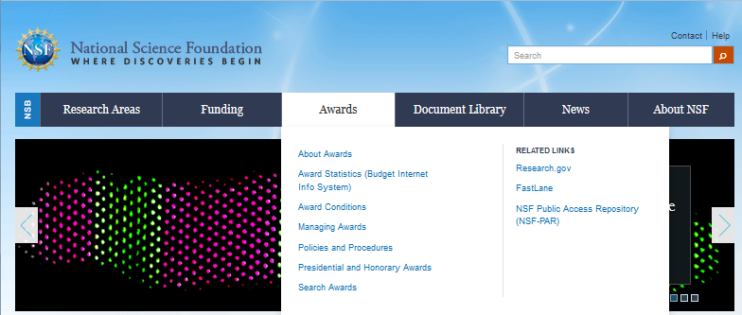
One way to learn about a given Program is to look at the grants that are currently funded by that Program.
www.nsf.gov – Search NSF Award Database
Notes:
Be familiar with projects that have succeeded - Award Abstracts at http://www.nsf.gov/awardsearch

Slide 18
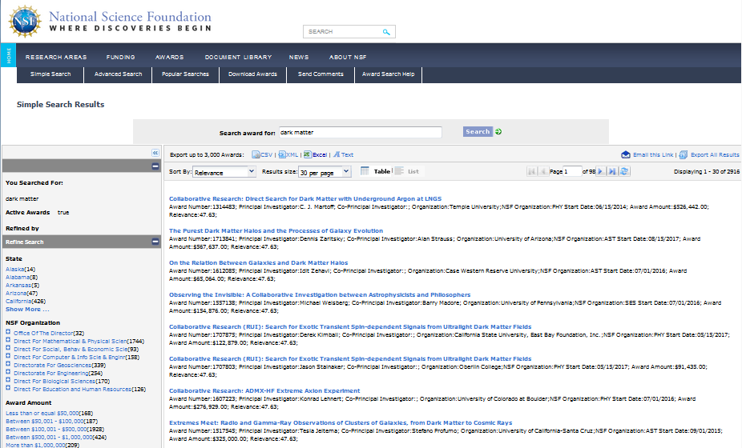
www.nsf.gov/awardsearch
‘dark matter’
Click on any grant
Notes:
Be familiar with projects that have succeeded - Award Abstracts at http://www.nsf.gov/awardsearch

Slide 19
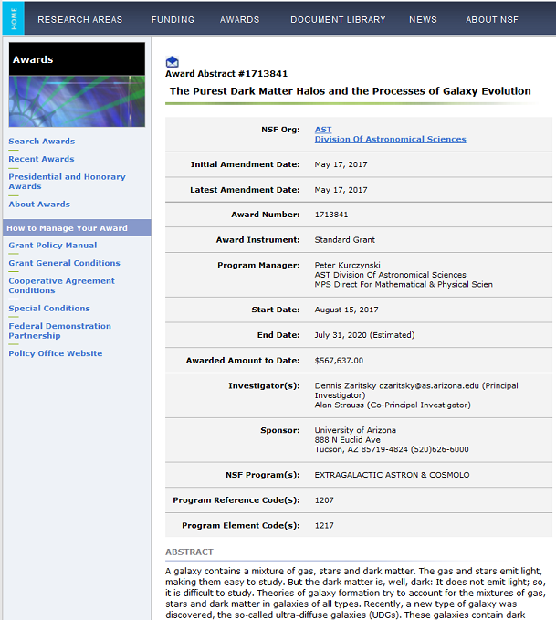
Division that made the award.
Program Director currently managing the award.
Funds allocated to date. See ‘expired’ awards for standard level of investment per award.
Program(s) that funded this award.
Abstract for this award –
reviewing abstracts provides information on research scope of the program!
Notes:
Be familiar with projects that have succeeded - Award Abstracts at http://www.nsf.gov/awardsearch

Slide 20
You and your American partner(s) may also wish to contact the relevant Program Director and discuss your ideas.
  Don’t be shy --- Program Directors would rather fill you in early than receive an inappropriate proposal later.
  Do not request a scientific evaluation from the Program Director. Ask only about appropriateness for the Program he/she oversees.
  Email first to set up a good time to phone or skype.
  Let your American partner make the first contact and lead the conversation. The NSF Program Director is probably thinking mostly in terms of funding the American side of your collaboration, not the Israeli side, so your American partner should probably take the initiative here.

Slide 21
The second part of deciding whether to apply concerns your choice of a suitable US partner.
Common questions…
Is it better to choose someone with previous NSF experience?
Someone who has existing NSF funding?
Someone who is more junior versus more established?
Someone from a “famous” institution?
etc…

Slide 22
The second part of deciding whether to apply concerns your choice of a suitable US partner.
Common questions…
Is it better to choose someone with previous NSF experience?
Someone who has existing NSF funding?
Someone who is more junior versus more established?
Someone from a “famous” institution?
etc…
In my opinion as a Program Director managing a core scientific program,
these are the wrong questions!

Slide 23
Just as you didn’t choose your career based on a particular funding opportunity, you shouldn’t choose your collaborators this way either.
You know what interests you, and what your main lines of research are
You know which Americans have similar or complementary research backgrounds which will enhance your research and vice versa.
You’re probably already “close” to these individuals, talking extensively with them at conferences, hiring their students as your postdocs (and vice versa), perhaps even refereeing their papers, etc.
Maybe you’ve already formed a collaboration, or talked about doing so.
These are your natural collaborators!
Such a collaboration develops naturally --- indeed, organically --- and is therefore credible. Outside experts in your field will see it this way and want to support it. You cannot “force” this into existence. A credible collaboration is unbeatable, and should supersede all other concerns.

Slide 24
That said, the identity of your collaborator can have a smaller effect on your funding probability...
It is helpful if he/she has previous NSF experience?
  Yes, if he/she knows what NSF expects and how to write a proposal.
Is it helpful if he/she has existing NSF funding?
  Not necessarily. Could even hurt: Some programs have limitations on applications from American PIs with current NSF funding. There are also NSF-wide limits on total summer salaries.
Is it helpful if he/she is more junior, or more established?
  NSF does not discriminate in this way. Commitment and relevance to the project is the important thing. However, funding to members of under-represented groups (women, African-Americans, Hispanics, etc.) can increase the diversity of the program, which is an asset.
Is it helpful if he/she is from a “famous” institution?
  Not necessarily. NSF funds all sizes and types of institutions. NSF even has special pots of money for proposals that come from scientifically-disadvantaged parts of the US (see EPSCoR). Note that Lead PI must work at a US academic or non-profit institution. Some programs allow private companies to apply (not a federal lab or NIH intramural researcher).

Slide 25
Step 2: Prepare your proposal
In general, your proposal must comply with three sets of rules/expectations:
Those listed in the “Dear Colleague Letter” (DCL) which provides general instructions for all NSF-BSF proposals, regardless of the individual NSF program: https://www.nsf.gov/pubs/2017/nsf17120/nsf17120.jsp
Those listed in the PAPPG (minimal NSF-wide expectations/requirements for all proposals to NSF) [last update 2/2019 --- keep checking!] https://www.nsf.gov/publications/pub_summ.jsp?ods_key=nsf19001
Those listed in the Solicitation (specific to program, may supplement or override the PAPPG)

Slide 26
Parts of an NSF Proposal
Non-conforming proposals may be returned without review!!!
Cover Page
Project Summary --- must explicitly and separately address Intellectual Merit and Broader Impact
Project Description --- must explicitly and separately address Intellectual Merit and Broader Impact; also include Results from Prior NSF support; describe US/Israel collaboration and how it will operate
References -- All authors, titles of articles
Biographical Sketches
Budget and Budget Justification --- your declaration about the funds you need for the proposed research (including overhead, etc.)
Current and Pending Support
Post Doc Mentoring Plan --- if needed, one page in Supplementary Docs
Data Maintenance Plan --- max two pages in Supplementary Docs
Collaborator & Other Affiliations List --- needed for Israelis too! PhD advisors and students, collaborators, etc. Read rules carefully.
Other Documents (suggested Reviewers, commitment letters, etc.)… see PAPPG
Notes:
Proposals MUST conform to the GPG requirements unless deviations are specifically authorized in advance.
through specification of different requirements in an NSF solicitation;
If any PI or co-PI identified on the project has received NSF funding in the past five years, information on the award(s) is required. Each PI and co-PI who has received more than one award (excluding amendments) must report on the award most closely related to the proposal.

Slide 27
Special instructions for NSF-BSF proposals
In Project Description, describe an integrated collaborative US/Israeli effort. Outline role of Israeli investigators and how the US and Israeli components will work together.
Title for proposal must have the prefix “NSF-BSF:”
Do not check “collaborative” box unless multiple US institutions are involved.
List Israeli PIs as “Senior Personnel”, not as PIs or co-PIs.
List “N/A” for Current and Pending Support for Israeli PIs who have no American sources of current or pending funding. Note that NSF-BSF funding for Israelis is not American support (since funds come from BSF).
Biographical Sketches should be provided for Americans and Israelis, along with Collaborator and Other Affiliations forms for each.
Postdoctoral Mentoring Plan required if postdoc funding is requested. How will you develop the career of the postdoc, help build their professional network, enable them to transfer to permanent job?
Israeli portion of budget should be provided as a Supplementary Document, along with Budget Justification, in English and in US dollars. Follow BSF rules/expectations for this budget. Don’t forget costs of adequate travel between US and Israel in support of collaboration!!

Slide 28
Things to consider while writing
Why this research project? Address an important problem.
Why you and not someone else?
  Uniqueness of qualifications, available facilities, educational opportunities, etc…
Capture the reviewers’ attention in the Summary and Introduction. Maintain enthusiasm. Make them want to read more. YOU must convince the reviewer you are worthy of funding
Describe the mechanics of the US/Israel collaboration. How will the collaboration function? Explain all issues and show you’ve carefully considered all angles.
Express yourself clearly. It’s not the reviewer’s job to figure out what you are trying to accomplish and why. Good expository writing is key!

Slide 29
Moreover, if appropriate (e.g., experimental proposal)…
Create a strong, clear, testable hypothesis
Provide comprehensive background and preliminary data to justify the hypothesis, specific aims and experimental plan
Write the experimental plan as if reviewers do not know what you know about the technology, methods, etc.
Demonstrate that each (and every) aim supports the hypothesis
Spell out plans for collaboration between the two labs (and include funding for it!)
Include plans for assessing the results of outreach, training, education efforts

Slide 30
Step 3: Your proposal is reviewed.
Proposals are evaluated by combination of
  External (“ad-hoc”) reviews: Program Director selects experts from relevant scientific community to evaluate proposal on its intrinsic merits and supply written review and overall score
  Panel evaluation: Program Director convenes Panel of experts from community to evaluate proposal and compare it with competing proposals in order to develop recommended relative rankings. Panel ultimately writes Panel Summary outlining their recommendation and why.
Within the constraints of available funding, Program Director then makes “final” decisions: which proposals and at what funding levels? Funding levels might be negotiated with PI as needed. NSF rarely offers the full amount requested!
Division Director then “concurs”, giving final scientific approval. Results also communicated to BSF. If funding recommended, NSF’s Division of Grants and Agreements then gives final overall approval and establishes the new grant. BSF does same.
Congratulations!

Slide 31
It may happen that your proposal reaches beyond a single Program. Two examples relevant for NSF-BSF are:
NSF’s “Ten Big Ideas”, six of which are
Read about them online. If your proposal connects to a Big Idea, special reviewing and funding opportunities (for the US side) might be possible, which might be a strength for your proposal.
Interdisciplinarity: If your proposal involves multiple NSF programs, you can indicate this on the Cover Page. It could potentially be co-reviewed (and the US side co-funded) by both programs, even across NSF Divisions. This is easiest if each program participates in the NSF-BSF initiative.

Slide 32
But how are these decisions made?
What criteria are imposed at each stage of the reviewing process?

Slide 33
Merit Review Criteria
NSF-funded Projects are expected to be of the highest intellectual quality with the potential to advance --- if not transform --- the frontiers of knowledge.
Projects are also expected to contribute more broadly to achieving societal goals, either through the research itself or through activities related or complementary to the research.
Two Merit Review criteria are considered when evaluating ALL NSF proposals:
Intellectual Merit: the potential to advance knowledge
Broader Impacts: the potential to benefit society and contribute to the achievement of specific, desired societal outcomes
Notes:
BOTH Criteria important and need to be addressed as integral part of Project Description
Be aware of new policy: One page Project Summary must “clearly address, in separate statements within the one-page limitation, both of the NSF merit review criteria in the Project Summary.

Slide 34

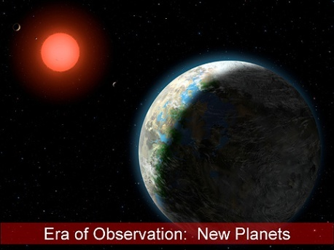

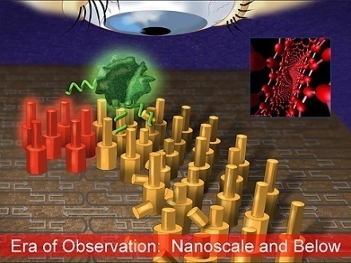

Intellectual Merit
For example…
How important is the proposed activity to advancing knowledge and understanding within its own field or across different fields?
How well qualified is the proposer
(individual or team) to conduct the
project?
To what extent does the proposed
activity suggest and explore creative,
original, or potentially transformative
concepts?
How well conceived and organized is
the proposed activity?
Is there sufficient access to resources?

Slide 35



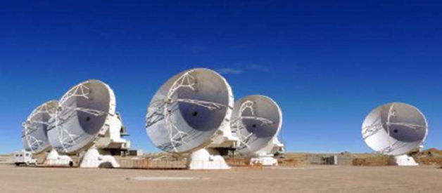

Broader Impacts
For example…
How well does the activity advance discovery and understanding while promoting teaching, training, and learning?
How well does the proposed activity broaden the participation of underrepresented groups?
To what extent will it enhance the infrastructure for research and education, such as facilities, instrumentation, networks, and partnerships?
Will the results be disseminated broadly to enhance scientific and technological understanding?
What may be the benefits of the proposed activity to society?

Slide 36
Examples of Broader Impacts
Examples include, but are not limited to:
  improved STEM education and educator development at any level;
  increased public scientific literacy and public engagement with science and technology;
  increased participation of women, persons with disabilities, and underrepresented minorities in science, technology, engineering, and mathematics (STEM);
  improved well-being of individuals in society;
  development of a diverse, globally competitive STEM workforce;
  enhanced partnerships between academia, industry, and others;
  improved national security;
  enhanced economic competitiveness of the US;
  enhanced infrastructure for research and education.
NSF Broader Impacts are (intentionally) broadly defined.
Notes:
BOTH Criteria important and need to be addressed as integral part of Project Description
Be aware of new policy: One page Project Summary must “clearly address, in separate statements within the one-page limitation, both of the NSF merit review criteria in the Project Summary.

Slide 37

But that is not all. All of the input from ad-hoc reviewers and Panelists is merely advisory to the Program Director. Even after the reviewer and Panel assessments and rankings are provided, Program Directors can still choose to fund or not fund based on additional scientific and criteria.
Note: NSF Program Directors generally hold PhD’s in their fields, and many/most are either current or former University professors who have led (or continue to lead) their own research programs “on the ground”. They are deeply engaged and many remain research-active themselves. They know their stuff.
Using this expertise, there are several additional things NSF Program Directors consider when developing their funding plans…

Slide 38
Programmatic Balance (Scientific)
Does the funded research portfolio support emerging growth areas as well as areas critical for ongoing scientific operations, capitalizing on prior research investments?
Is there a mix of solid bread-and-butter as well as transformative (high-risk/ high-reward) research? Of disciplinary as well as inter-disciplinary research?
Is the Program portfolio well-poised to take advantage of new scientific breakthroughs and emerging disciplines and technologies?
Integration of Research and Education
Fostering integration of research and education through the programs, projects, and activities NSF supports at academic and research institutions is deemed critical.
Integrating Diversity into Programs, Projects, and Activities
Broadening opportunities and enabling the participation of all citizens --- men and women, underrepresented minorities, and persons with disabilities --- is essential to the health and vitality of the entire scientific enterprise.
Each year, many scientifically strong proposals are left unfunded. Scientific excellence is not the only consideration!

Slide 39
Many funded NSF proposals were declined on their first attempts.
If your proposal is declined, the American PI will receive copies of
  all of the ad-hoc reviews of your proposal, and/or
  the Panel Summary, which summarizes the deliberations of the Panel and explains their reason for your overall Panel ranking.
Treat this as a learning experience!
You may also discuss the review outcome with the Program Director to get further input and advice.
Sometimes it may make sense to submit a new proposal the next year. If you do so, be sure that you have modified your proposal in order to successfully address the specific comments of the reviewers. If so, your proposal will be admitted into the next competition and be judged fresh as a new proposal.

Slide 43
Overview of NSF-BSF Success Rates
(by Program)
Division or program | FY 2014 | FY 2015 | FY 2016 | FY 2017 | FY17 NSF funding rates
BIO/DEB |  | 3 (33%) ** | 9 (33%) ** | ? | 24%
BIO/IOS |  |  | 12 (33%)** | 4 (?) | 19%
BIO/IOS EDGE |  |  | 2 (0%)
BIO/MCB |  |  | 37 (11%) | 28 (25%) | 17%
BIO Ecol. Evol. Of Inf. Disease |  | 3 (33%) | 0
CISE/CCF |  |  | 17 (29%) | 21 (38%) | 22%
CISE/CNS |  |  |  | 2 (100%) | 21%
CISE/IIS (joined 2017) |  |  |  |  | 14%
CISE/SaTC |  | 12 (33%) | 12 (25%) | 10 (40%)
CRCNS | 12 (8%) | 14 (14%) | 12 (25%) | 15 (33%)
BRAIN (EAGER FY14-15 only) | 49 (6%) | 1 (100%?)
ENG/ECCS |  |  | 12 (33%) | 4 (25%) | 19%
ENG/CBET Sust. Energy |  |  | 10 (10%) | 8 (25%)
ENG/CBET (all programs in 2019) |  |  |  |  | 14%
GEO/EAR |  |  | 12 (25%) | 5 (20%) | 26%
GEO/OCE | 10 (10%) | 7 (0%) | 20 (25%) | 6 (??) | 29%
MPS/DMR |  |  | 48 (25%) | 38 (21%) | 19%
MPS/PHY |  | 24 (29%) | 16 (31%) | 10 (20%) | 31%

Slide 44
Final Tips for a Successful Review
Know the rules. Make sure your proposal is compliant.
NSF takes the Broader Impacts very seriously. Devote a good fraction (approx. 20-30%) of your proposal to this section. Don’t just brush it off or give platitudes. How large an audience will be reached? Develop an assessment plan to determine the effectiveness of your efforts.
There is no special pot of NSF-BSF money. NSF-BSF proposals compete against regular proposals within each program. Why should this proposal be funded at the expense of a “regular” proposal? The proposed research must be competitive regardless of the international connection.
Are the US and Israeli components equally strong? NSF reviewers will evaluate each side as well as the collaboration. If either side is deemed weak, the whole proposal will fare poorly.
The US/Israel collaboration must be genuine and transcend what each component could accomplish on its own. What new synergies or opportunities does this format provide, and has this proposal capitalized on them? Benefits for students and postdocs?? This includes not only Intellectual Merit but also Broader Impacts. Think creatively about this!

Slide 45
Final Tips for a Successful Review
In discussing the research plan, motivate both the general (why is this research question an important one?) and the specific (why will we succeed whereas others might not have made progress?).
External “ad hoc” reviewers will generally be experts in your research area. Know the literature! Give a detailed research plan, but avoid unnecessary jargon. Will there be specific deliverables on each side?
By contrast, Panelists are likely to be drawn from a larger pool of experts beyond your own research subspecialty. Reading the Abstracts of grants already funded in the Program will give you an idea of entire scientific scope of the Program, and thus the likely makeup of the Panel and their research specialties. Your proposal should aim to impress as many of the Panelists as possible.
Funding in the US has become increasingly competitive. American reviewers are likely to react negatively if the US side appears to exploiting the NSF-BSF program in order to get “yet another” grant or to overcome weaknesses of their own. Put the science first!
By contrast, Panelists are usually excited to learn that BSF commits to fund the Israeli side if they give the green light. They intrinsically want to do this. To help seal the deal, make them feel that this is a good investment.

Slide 46

Good luck!
!
בהצלחה

