Slide 1
NSF-BSF Collaborations in Biology
Dr. Michelle Elekonich, September 2015

Slide 2

NSF At A Glance
U.S. Federal Agency- part of the Executive Branch
  ~3000 employees
Budget: ~ $7 Billion
~11,000 awards per year from > 51,000 submissions/yr.
NSF funds all areas of basic research except for biomedical research
Supports about 60% of the basic biology research performed at American universities

Slide 3





Where Does NSF Fit?
Basic
Translation
(NIH, USDA,DOE etc)
Utility
US PI and ISRAELI COLLABORATOR SHOULD TALK TO A PROGRAM DIRECTOR IF THERE ARE QUESTIONS ABOUT FIT

Slide 4
NSF-BSF IOS/DEB/MCB Dear Colleague letters
All 3 research divisions within the Biology Directorate have issued Dear Colleague Letters to collaborate with BSF
    NSF will fund US PI(s) while BSF will fund Israeli PI(s)
    NSF forms filled out by US PI; BSF forms filled out by Israeli PI
In all cases, proposals submitted under the DCL are part of the regular core programs proposal review process and do not undergo separate review.
    Identified by prefacing the proposal title with “NSF-IOS-BSF:” or “NSF-DEB-BSF:” or NSF-MCB-BSF:”
Notes:
Follow the BSF instructions!!!!
IN DEB LTREB and EEID are also included

Slide 5
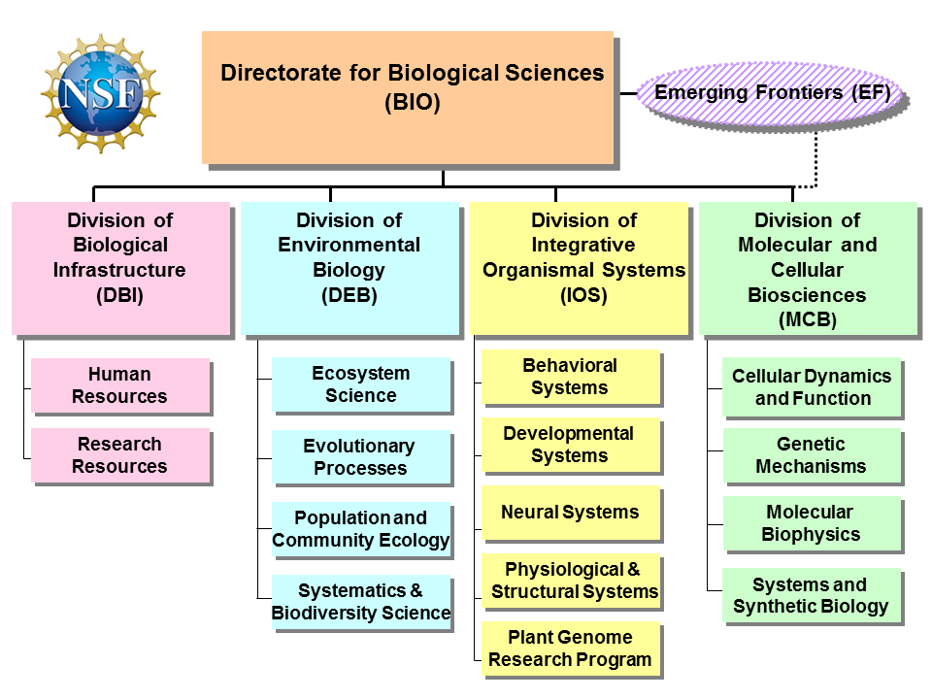
WHERE DOES YOUR SCIENCE FIT?
Notes:
Arranged by scale; about the questions not about your techniques or your identity

Slide 6
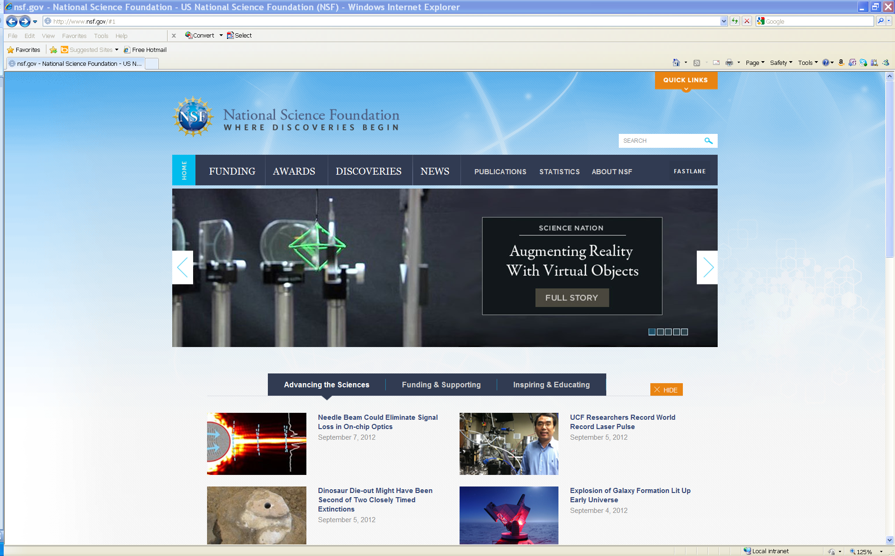
Where do I find information about What is BEING FUNDED?
www.nsf.gov

Slide 7
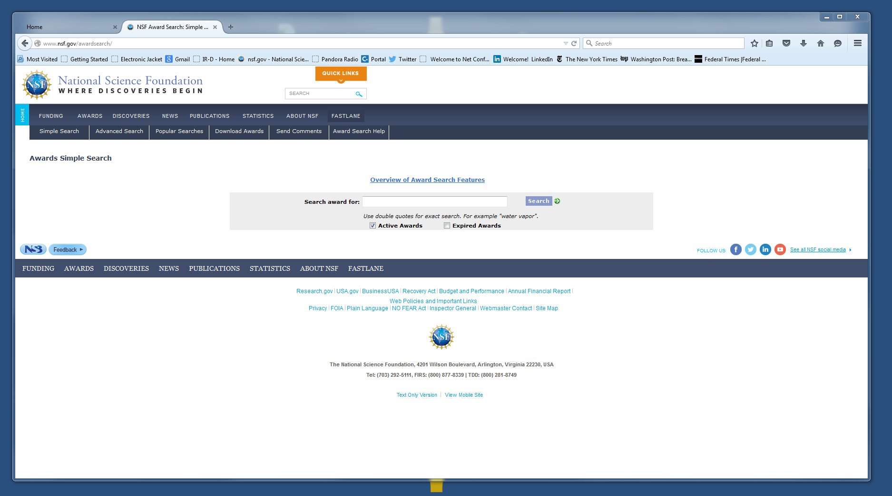

Slide 8
NOT SURE? ASK A PROGRAM DIRECTOR
COMMUNICATION IS AN IMPORATANT PART OF THE NSF CULTURE
  NSF Program Directors will be happy to talk with your US collaborator (lead) and you prior to submission
    US PI should send email to Program Director to set up a time, cc collaborator
    Can Skype or WebEx or Call so all can be involved

Slide 9
Picking a U.S. collaborator
Useful if he/she has previous NSF experience, but not required
May or may not already have NSF funding
  Programmatic considerations may affect likelihood of funding to someone who has NSF funding
NO preference for established investigators – pick the best skills/expertise for the project not necessarily the biggest name.
Looking for a real collaboration! Commitment from US PI is important.
NSF has NO preference for particular institutions; NSF funds all sizes and types.
Cannot submit the same proposal to more than one part of NSF, or to multiple American agencies*
The programs within the Biology Directorate do NOT support biomedical research; collaborator must do basic research
Lead PI cannot be a U.S. federal employee or at a Federal Lab
Notes:
** except for Beginning Investigators

Slide 10
WHAT IS THE PROCESS?
Preliminary Proposals due in January
Invitations issued in May
Invited Full Proposals due in August
Full Proposals only
due in November
Notes:
Arranged by Scale
IN DEB- BSF collab w their core program, EEID and LTREB
IOS and MCB – core programs only – not PGRP

Slide 11
Parts of a preliminary Proposal
Cover Sheet
  Title of Proposed Project:
Project Summary (1 page)
Project Description Maximum 5 pages total, containing the following two sections
    Section I. Personnel (1 pg.)
    Section II. Project (4 pgs.)
References Cited (maximum 3 pages)
Biographical Sketches for each person listed on the Personnel page. (2-page limit for each)
Combined Conflict of Interest document. http://www.nsf.gov/bio/ios/ioscoitemplate.xlsx

Slide 12
Preliminary Proposal Project Description Content
Distribution across the 4 pages of the Project Description is at the PIs discretion
Why, What and WOW! Plus Broader Impacts
The narrative of a pre-proposal should address the:
  Main idea or set of concepts that the PIs intend to address
  Significance/Impact of those questions or rationale for why one would want to address the issues
  Specific questions, hypotheses or aims the PI intends to pursue to be able to address the issues
  Research approaches or experimental plan
  Ability of the team to conduct the research
  Broader impacts (Separate Section now required in all Project Descriptions!)
Notes:
From Steve K: For slides 15 & 16, 'pre-proposal content' and 'basis for decision', we should mention that the pre-proposal must include enough detail to enable reviewers to evaluate it, including showing their preliminary data, and describing expected outcomes and interpretations.

Slide 13
A strong pre-proposal….
..made a strong and a believable case that the proposed research and broader impact activities are feasible and likely produce large advances in the field.
..included enough detail to enable reviewers to evaluate it, including essential preliminary data where appropriate, and describing expected outcomes and interpretations.

Slide 14
Parts of a Full Proposal
Cover sheet and certifications
Project summary
Project description (15 pages)
References cited
Forms
  Biographical sketches (specified format)
  Current and pending support
  Facilities, equipment and other resources
Budget
Supplementary Documents (no reprints, preprints, letters of general support or endorsement)
  Data management plan
  Postdoc mentoring plan (if applicable)
  Letters of collaboration (if applicable) following the specific template in the solicitation
Single copy documents
    BIO classification form
    List of Suggested reviewers (optional)
COI template
Notes:
Longer and adds a lot of forms/documentation and of course a budget!

Slide 15
A strong Full Proposal….
Similarly to a preliminary proposal a full proposal addresses both intellectual merit and broader impacts but in more detail.
A strong full-proposal… is one that maintains the high enthusiasm for the proposed activities in the preliminary proposal even after the full implementation plan is articulated in detail.

Slide 16
NSF’s Two Merit review criteria
I. What is the intellectual merit of the proposed activity?
II. What are the broader impacts of the proposed activity?

Slide 17
What is Intellectual Merit?
Quality of the science
  Does it answer a large important question in basic biology?
  Is it novel and exciting?
  Will it move the field forward?
  Is it well conceived and well planned?
      Experimental Design is feasible, has well thought out alternatives and tests the questions asked

Slide 18
What are Broader Impacts?
Integrated activities that:
Promote teaching, training and learning
Broaden participation of underrepresented groups
Enhance infrastructure for research and education
Broadly disseminate findings
Benefit society
  Can include potential applied uses
http://www.nsf.gov/pubs/gpg/broaderimpacts.pdf
Not a checklist!

Slide 19
Examples of BROADER IMPACTS Activities
Partner with museums, nature centers, science centers, and similar institutions to develop exhibits in science, math, and engineering.
Citizen Science Activities - involve the public where possible, in research and education activities.
Give science and engineering presentations to the broader community (e.g., at museums and libraries, on radio shows, and in other such venues).
Participate in multi- and interdisciplinary conferences, workshops, and research activities
Integrate research with education activities

Slide 20
Potentially Transformative Research
NIH….translational
NSF…transformative
Is it transformative?
  “Transformative research involves ideas, discoveries, or tools that radically change our understanding of an important existing scientific or engineering concept or educational practice or leads to the creation of a new paradigm or field of science, engineering, or education. Such research challenges current understanding or provides pathways to new frontiers.”
A proposal does NOT have to be deemed potentially transformative to be funded, but should have strong potential for impact on the field

Slide 21
How The Biology Directorate reviews Proposals
Preliminary Proposals (IOS and DEB)
  Panel review only, 3 reviews and a panel summary
  BSF can send panelists
Full Proposals (IOS, DEB and MCB)
  Panel review- 2-4 panelist reviews and a panel summary
  Additional written mail in reviews
  BSF can suggest reviewers or panelists
  In all cases reviews are advisory to the Program Directors
Program Directors make the final funding decisions based on program portfolio balance and program priorities, budget availability, and demographic/geographic considerations

Slide 22
IOS Core PROGRAMS Proposal Success Rates
IOS (all clusters/programs) | 2012 |  | 2013 |  | 2014 |  | 2015
 | n | % | n | % | n | % | n | %
Preliminary proposals - January | 1,824 |  | 1,957 |  | 1,980 |  | 1,936
Invitations (projects) - May | 545 | 29.9% | 426 | 21.8% | 465 | 23.5% | 454 | 23.5%
Full proposals received (incl. collabs) – August | 642 |  | 507 |  | 712 |  | 566
Funded full proposals (incl. collabs) November to September | 181 | 28.2% | 195 | 39.3% | 234 | 32.9% | **
Funded projects | 153 |  | 160 |  | 190
IOS Overall Success Rate |  | 8.4% |  | 8.6% |  | 8.9%
** will be reviewed in October 2015 panels
Notes:
In the one complete year under the new system . . .yrs at top of the chart are calendar yrs not fiscal years
We received 1836 Preliminary proposals in January
547 of those were invited to come back as full proposals
With Careers added to the prepropals invites we had 634 full proposals for review in fall panels
We ended up funding 175 full proposals
So the preproposal invite rate was 29.8%
The success rate of full grants was 27.6%
So success rate of proposals overall was 8%
Remember this was a year of reduced budgets

Slide 23
funding RATES ACROSS the Directorate for Biological Sciences
Division | Funding Rate | Actions | Awards
DBI | 28% | 510 | 144
DEB* | 23% | 1126 | 262
EF | 23% | 328 | 76
IOS* | 36% | 798 | 290
MCB | 16% | 1067 | 173
*These divisions have a two step process using preliminary proposals followed by invited full proposals
All of these data are for regular full proposals plus supplements, workshops and other kinds of awards
Notes:
Data from BIO website 8/12/15

Slide 24
OTHER NSF-BSF PROGRAMS:
Collaborative Research in computational Neuroscience (CRCNS)
Multiple Directorates in NSF and the U.S. National Institutes of Health
  Biology
  Social and Behavioral Sciences
  Computer and Information Sciences in Engineering
Multiple International Partners
  U.S. Israel Binational Science Foundation (BSF)
  French National Research Agency (ANR)
  German Federal Ministry of Education and Research (BMBF)
Solicitation: NSF 15-595
NSF Contact: Ken Whang kwhang@nsf.gov or Dana Hunter dmhunter@nsf.gov

Slide 25

Questions?
IOS: Michelle Elekonich
melekoni@nsf.gov or NSF-IOS-BSF@nsf.gov
http://www.nsf.gov/pubs/2015/nsf15090/nsf15090.jsp
MCB: Theresa Good
tgood@nsf.gov
http://www.nsf.gov/pubs/2015/nsf15105/nsf15105.jsp
DEB: NSFDEB-BSF@nsf.gov
http://www.nsf.gov/pubs/2014/nsf14094/nsf14094.jsp

