Slide 1


How to Succeed in NSF-BSF Proposals
Lara A. Campbell, Ph.D.
U.S. National Science Foundation
International Science & Engineering
May 2018
Notes:
Credit: NSF/Nicolle Rager Fuller

Slide 2
NSF Mission and Vision
To promote the progress of science; to advance the national health, prosperity, and welfare; and to secure the national defense; and for all other purposes. (From 1950 founding act)
  support basic research and people to create knowledge that transforms the future.
[To support the USA to be a] Nation that creates and exploits new concepts in science and engineering and provides global leadership in research and education.

Slide 3



NSF by the Numbers
93%
funds research,
education and
related activities
$7.8B
FY 2018
Enacted
50,000
proposals
evaluated
2,000
NSF-funded
institutions
11,000
awards
funded
359,000
people NSF
supported
$1.2B
STEM
education
$100M
to seed
public/private
partnerships
231
NSF-funded
Nobel
Prize winners
Numbers shown are based on FY 2018 activities.

Slide 4
NSF is Unique Among US Federal Agencies
Mandate to fund both research and education
Focus on basic research in all areas of science & engineering
All areas of science, engineering, computer science and social sciences are housed in one agency
Funding decisions are based on advisory peer review to program directors. Program Directors have discretion to set direction/balance portfolio

Slide 5
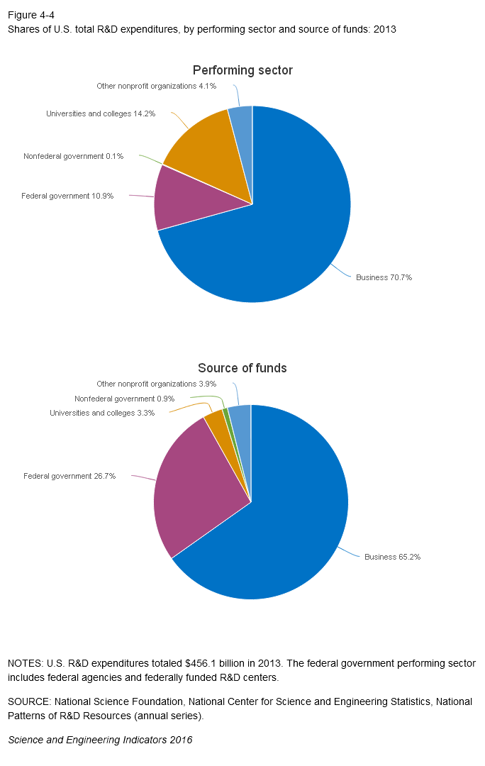
US R&D Funding and Performers
Notes:
Businesses perform 71% of R&D (more D than R)
US Federal Govt provides almost 27% of funds for R&D

Slide 6





NSF in the US Research Funding Landscape
Basic
Translation
(NIH, USDA, DOE etc.)
US PI and ISRAELI COLLABORATOR SHOULD TALK TO A PROGRAM DIRECTOR WITH QUESTIONS ABOUT FIT
Utility
Notes:
DCL requires that PIs reach out to POs prior to submission.

Slide 7
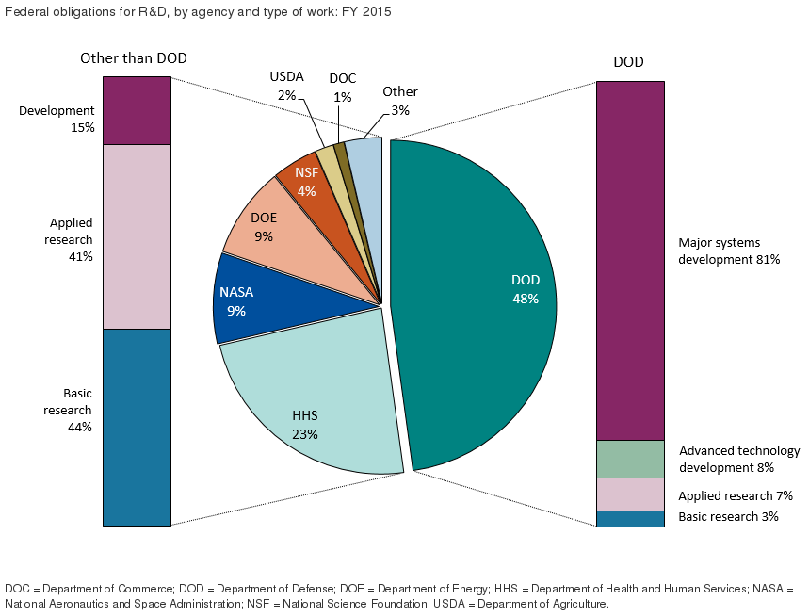
US Federal Funding of R&D

Slide 8

Fields Participating in the NSF-BSF Programs
BIO (Biological Sciences)
  Core Programs in: Environmental Bio, Integrative Organismal Systems, & Molecular & Cellular Bio
  Ecology & Evolution of Infection Diseases (EEID) program
CISE (Computer and Information Sciences & Engineering)
  Small Core Programs in Computing & Communication Foundations, Computer and Network Systems, & Information & Intelligent Systems
  Secure and Trustworthy Cyberspace (SaTC) program
  Collaborative Research in Computational Neuroscience (CRCNS) program
ENG (Engineering)
  Core Programs in Chemical, Bioengineering, Environmental and Transport Systems; 3 Core Programs in Electrical, Communications and Cyber Systems
GEO (Geosciences)
  Core Programs in Earth Sciences, and Ocean Sciences
MPS (Math and Physical Sciences)
  Core Programs in Materials Research, and Physics

Slide 9
How to Apply to NSF – BSF Programs
There is ONE “Dear Colleague Letter” with general instructions for ALL Participating NSF programs: https://www.nsf.gov/pubs/2017/nsf17020/nsf17020.jsp
Read the Instructions for BOTH NSF-BSF (the DCL) and for the Core NSF Program
List Israeli PI as Senior Personnel –
  BioSketch is uploaded in same section as US PI BioSketch
  BSF budget (in US dollars) included as supplemental document
Make sure you describe the collaboration (what each team will do), how expertise is relevant/valuable, & history of collaboration
Notes:
Submit PDF of NSF proposal (produced by FastLane or Research.gov) to BSF within 10 days
Different programs have limits on number of proposals each researcher may submit and many other rules.

Slide 10
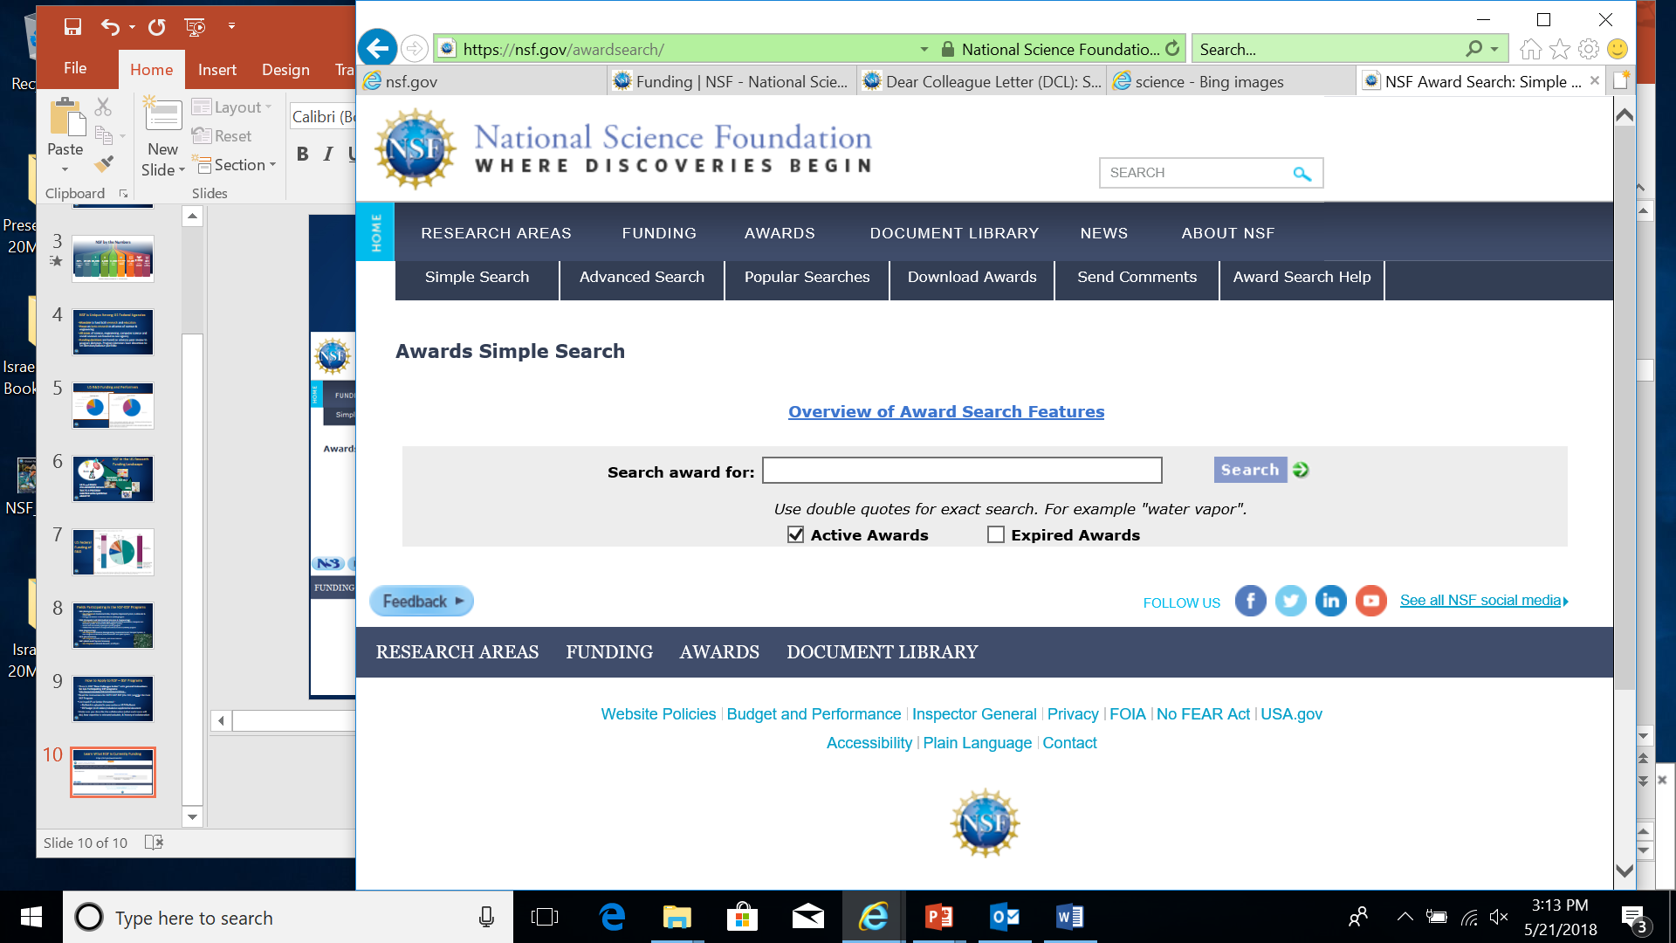
Where Does Your Idea Fit?
https://nsf.gov/awardsearch/
Notes:
Boolean terms

Slide 11
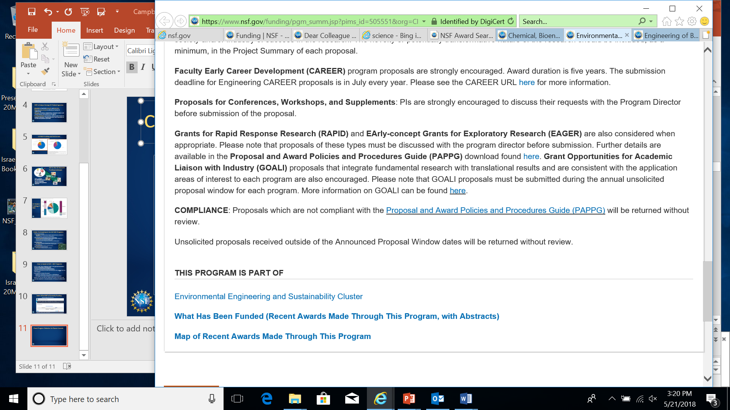
Check Program Websites for Recent Awards
Very bottom of program page:

Slide 12


Not Sure? Ask a Program Director!
COMMUNICATION IS AN IMPORATANT PART OF THE NSF CULTURE
NSF Program Directors will (generally) be happy to talk with your US collaborator (US PI) and you prior to submission
  US PI should send an email to Program Director to set up a time, cc Israeli collaborator
  Summarize what you want to propose and questions in the email.
Can Skype or WebEx or Call so all can be involved

Slide 13
Picking a US Collaborator
Useful if she/he has previous NSF experience, but not required
May or may not currently have NSF funding
  Some programs have limitations on applications from Pis with current NSF funding
NO preference for established investigators – pick the best skills/expertise for the project not necessarily the biggest name.
Reviewers look for real collaboration! Commitment from US PI is important.
NSF has NO preference for particular institutions; NSF funds all sizes and types.
Cannot submit the same proposal to more than one part of NSF, or to multiple American agencies
Lead PI must work at a US academic or non-profit institution, some programs allow private companies to apply (not a federal lab or NIH intramural researcher).

Slide 14
NSF Review Criteria
Intellectual Merit – Quality of the Science
  Does it answer a large important question?
  Is it novel and exciting?
  Will it move the field forward?
  Is it well conceived and well planned? (Experimental Design is feasible, alternatives well thought out, and methods will test the questions asked)
Broader Impacts – Benefits to Society
  Promoting teaching, training, learning
  Broaden the participation of underrepresented groups
  Enhance infrastructure for research and education
  Broad dissemination of findings
  Applications
  Required for the US-side, optional for the Israeli side, but great opportunity to cooperate!
Activities are integrated into the project!
Not a checklist!
Notes:
Transformative…

Slide 15
Examples of BROADER IMPACTS Activities
Partner with museums, nature centers, science centers, etc. to develop exhibits in science, math, and/or engineering.
Citizen science activities—involving the public in research and education activities.
Engage the broader community (e.g. give talks at museums, libraries, on radio shows, at schools).
Integrate research with education activities (e.g. develop new curriculum)
Developing STEM pipeline (e.g. engage disadvantaged groups, teacher training, K-12 activities).
Developing research resources to share with other fields
Requirements in NSF Proposal & Award Policies & Procedures: https://www.nsf.gov/pubs/policydocs/pappg18_1/pappg_3.jsp#IIIA2b
Helpful information at the National Alliance for Broader Impacts: https://broaderimpacts.net/

Slide 16
Potentially Transformative Research
Is it transformative?
  “Transformative research involves ideas, discoveries, or tools that radically change our understanding of an important existing scientific or engineering concept or educational practice or leads to the creation of a new paradigm or field of science, engineering, or education. Such research challenges current understanding or provides pathways to new frontiers.”
A proposal does NOT have to be deemed potentially transformative to be funded, but should have strong potential for impact on the field

Slide 17
Overview of Review Process
Program Director
Approves Panel Summary
Evaluates panel recommendations
Makes analysis & recommendation (award, decline)
Principal Investigator
Identify relevant NSF program
Develop proposal & submits into NSF Fastlane
Gets feedback before submitting
Review Panel
May include some or all of the Reviewers
Discuss Strengths/Weaknesses of Intellectual Merit & Broader Impacts
Assigned “Scribe” writes Panel Summary
Ranks your proposal
Program Director
Determines relevance of proposal to program
Develops thematic Panels
Recruits the Panelists
Assigns reviewers to proposal based on interest & expertise of panelist
Individual Reviewers (at least 3)
Prepare written reviews based on NSF Criteria (Intellectual Merit, Broader Impacts)
Have expertise in subject of proposal
Faculty (mostly), Gov’t (sometimes)

Slide 18
How Panels Rate Proposals
Highly Competitive | High Priority | Fund
Strongest in both intellectual merit and broader impacts
Most likely to contain transformative ideas
Competitive | Low Priority | Fund if Possible
Weaknesses in intellectual merit or broader impacts or both
Likely to have incremental impact
WOW!
Competitive | Medium Priority | Fund if Possible
Strong in both intellectual merit and broader impacts
Non-Competitive | Do Not Fund
Seriously flawed in some fundamental way
Missing some crucial element or idea
Notes:
Three or four buckets
Number in each can be based on the total amount of funds available, but often based just on excellence alone

Slide 19
Why Proposals May Score Poorly
Intellectual Merit
There is not a clear hypothesis
Question is not important
Findings won’t be applicable to broader science
Research won’t move the science forward
Preliminary data does not justify the experiments
Experimental plan is not clear
Aims are not clearly justified/explained
Technical concerns (expertise, equipment, time, funding)
Methods are not suitable for the work (e.g. computation)
Background and literature search too narrow

Slide 20
Why Proposals May Score Poorly
Broader Impacts
Activities are not sufficiently explained
There is no assessment plan
Activities do not reach a sufficiently broad audience
International Collaborations
How the groups will collaborate / interact is not explained
Role / expertise of the Israeli team is not explained

Slide 21
How Not to Get Funded
Program solicitation, PAPPG, DCL? Booooooring
Broader Impacts – Don’t waste your time explaining, it’s inherent in the work
Cram it in – I have so much to say I need tiny fonts and micro-margins
Make them earn it – Who needs section headers or structure?
Write for your friends – Everyone should know my subfield’s jargon
I’m the first! – no one has ever attempted to do anything like this before
Proofreading is for wimps
I’m the best! – No need to list students or collaborators, it’s just me, me, me

Slide 22
Recommendations!
Address an Important Problem and
Maintain Enthusiasm
Create a strong, clear, testable hypothesis
Provide comprehensive background and preliminary data to justify the hypothesis, specific aims and experimental plan
Write the experimental plan as if reviewers do not know what you know about the technology, methods, etc.
Demonstrate that each (and every) aim supports the hypothesis
Spell out plans for collaboration between the two labs (and include funding for it!)
Include plans for assessing the results of outreach, training, education efforts

Slide 25
Overview of NSF-BSF Success Rates
Division or program | FY 2014 | FY 2015 | FY 2016 | FY 2017 | FY17 NSF funding rates
BIO/DEB |  | 3 (33%) ** | 9 (33%) ** | ? | 24%
BIO/IOS |  |  | 12 (33%)** | 4 (?) | 19%
BIO/IOS EDGE |  |  | 2 (0%)
BIO/MCB |  |  | 37 (11%) | 28 (25%) | 17%
BIO Ecol. Evol. Of Inf. Disease |  | 3 (33%) | 0
CISE/CCF |  |  | 17 (29%) | 21 (38%) | 22%
CISE/CNS |  |  |  | 2 (100%) | 21%
CISE/IIS (joined 2017) |  |  |  |  | 14%
CISE/SaTC |  | 12 (33%) | 12 (25%) | 10 (40%)
CRCNS | 12 (8%) | 14 (14%) | 12 (25%) | 15 (33%)
BRAIN (EAGER FY14-15 only) | 49 (6%) | 1 (100%?)
ENG/ECCS |  |  | 12 (33%) | 4 (25%) | 19%
ENG/CBET Sust. Energy |  |  | 10 (10%) | 8 (25%)
ENG/CBET (all programs in 2019) |  |  |  |  | 14%
GEO/EAR |  |  | 12 (25%) | 5 (20%) | 26%
GEO/OCE | 10 (10%) | 7 (0%) | 20 (25%) | 6 (??) | 29%
MPS/DMR |  |  | 48 (25%) | 38 (21%) | 19%
MPS/PHY |  | 24 (29%) | 16 (31%) | 10 (20%) | 31%

Slide 26
NSF Awards Involving BSF
Data for 2017 incomplete.

Slide 27
QUESTIONS?
NSF-BSF DCL Lists a contact (or links to a page with contacts) for EVERY participating program
https://www.nsf.gov/od/oise/NSF-BSF/participating_programs.jsp
Lara Campbell: LCAMPBEL@NSF.GOV

